Slide 1
Audio Amplifier ENGE 312
Zach Wilson

Slide 2
General Description
This project is a general purpose audio amplifier made up of three stages using discrete components such as BJT and Mosfet transistors.

Slide 3
Design Constraints
Frequency response: 20 Hz - 20 kHz minimum
Sensitivity of 500 mV (minimum input for maximum output)
Input impedance of 50 kΩ
Input stage: Differential, single-ended in/out
Output stage: Class AB, BJT push-pull configuration (TIP41 and TIP42) using single supply
Maximize power efficiency – deliver 7.5 W† to an 8-Ω driver with minimal idle current
Must account for bias and temperature stability
Minimize harmonic distortion
Use standard resistor and capacitor values (thru-hole components)
Utilize at least one current source
Minimize capacitor values
Use 24 VDC, 1000 mA regulated power supply (ENGE 311 Project)
Max board size 4x6 inches (mono)

Slide 4
Trade Offs
Bigger capacitors vs. lower cutoff frequency
Overall swing vs. non-distorted signal
A 2200 µF capacitor was put in between VCC and Ground in front of the gain stage in order to combat a hum produced by the power supply interacting with the amplifier. This doesn’t exactly minimize cap values, however at this point stopping the hum was more important.
The Push Pull capacitors were increased to 47 µF in order to obtain a clearer signal.
Gain was another tradeoff in order to prevent the amplifer from clipping. The differential stage had too much gain so the drain resistances were dropped and a source resistance was added to drop it down to one (V/V).

Slide 5
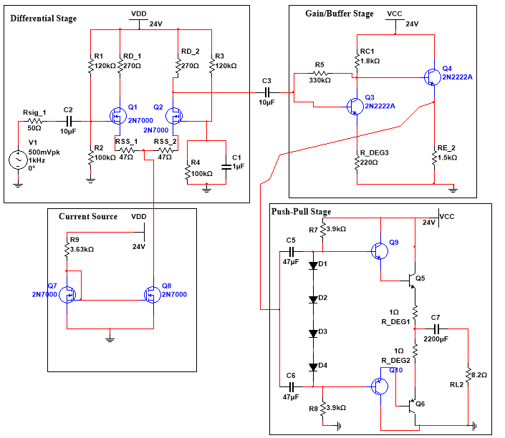
The signal enters through the differential in order to minimize noise. The biasing of the differential is controlled via the current source below. It then enters into the gain/buffer stage in order to amplify the signal. This is passed to the Push-Pull stage, or the “Power Stage”. This final stage drives the speaker and produces audible sound.

Slide 6
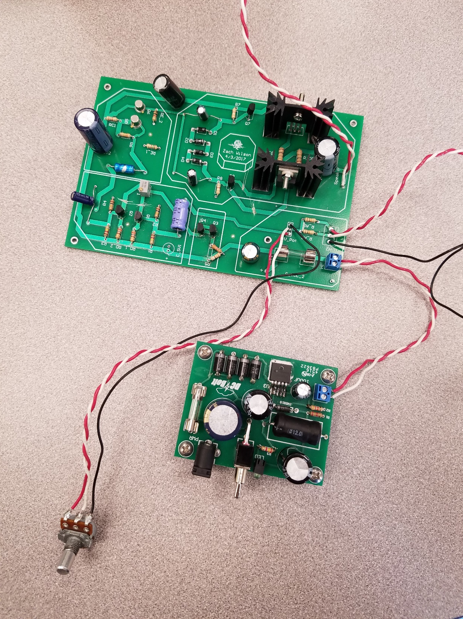
The PCB at top is the overall audio amplifier circuit, found in the schematic in the previous slide. Attached below the audio amp is the 24V DC power supply, which converts wall outlet voltage into a VCC that is usable by the amplifier.

Slide 7
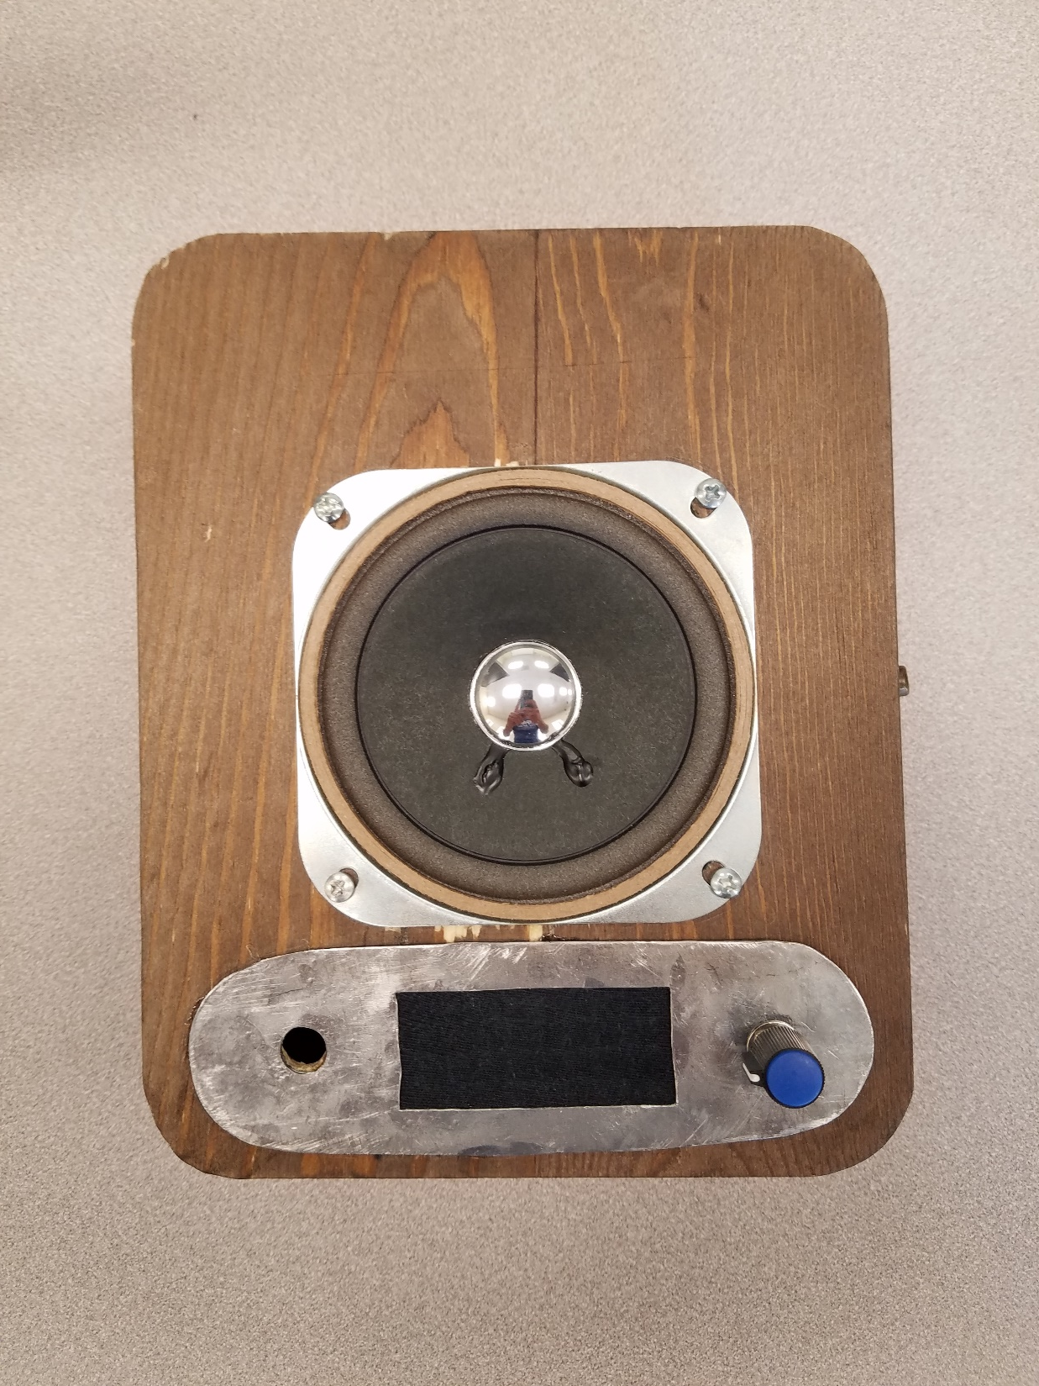
This is the enclosure for the project. It features a high class, intensely engineered wooden box from GoodWill. The panel below the speaker was milled in the George Fox University Machine Shop, and filed around it’s edges to ensure proper curvature. It was then drilled using a press, to allow the auxiliary input portal and potentiometer slot. There is a resonance gap in the panel to allow for higher quality sound, using a wire mesh for support and black fabric to cover the gap.

Slide 8
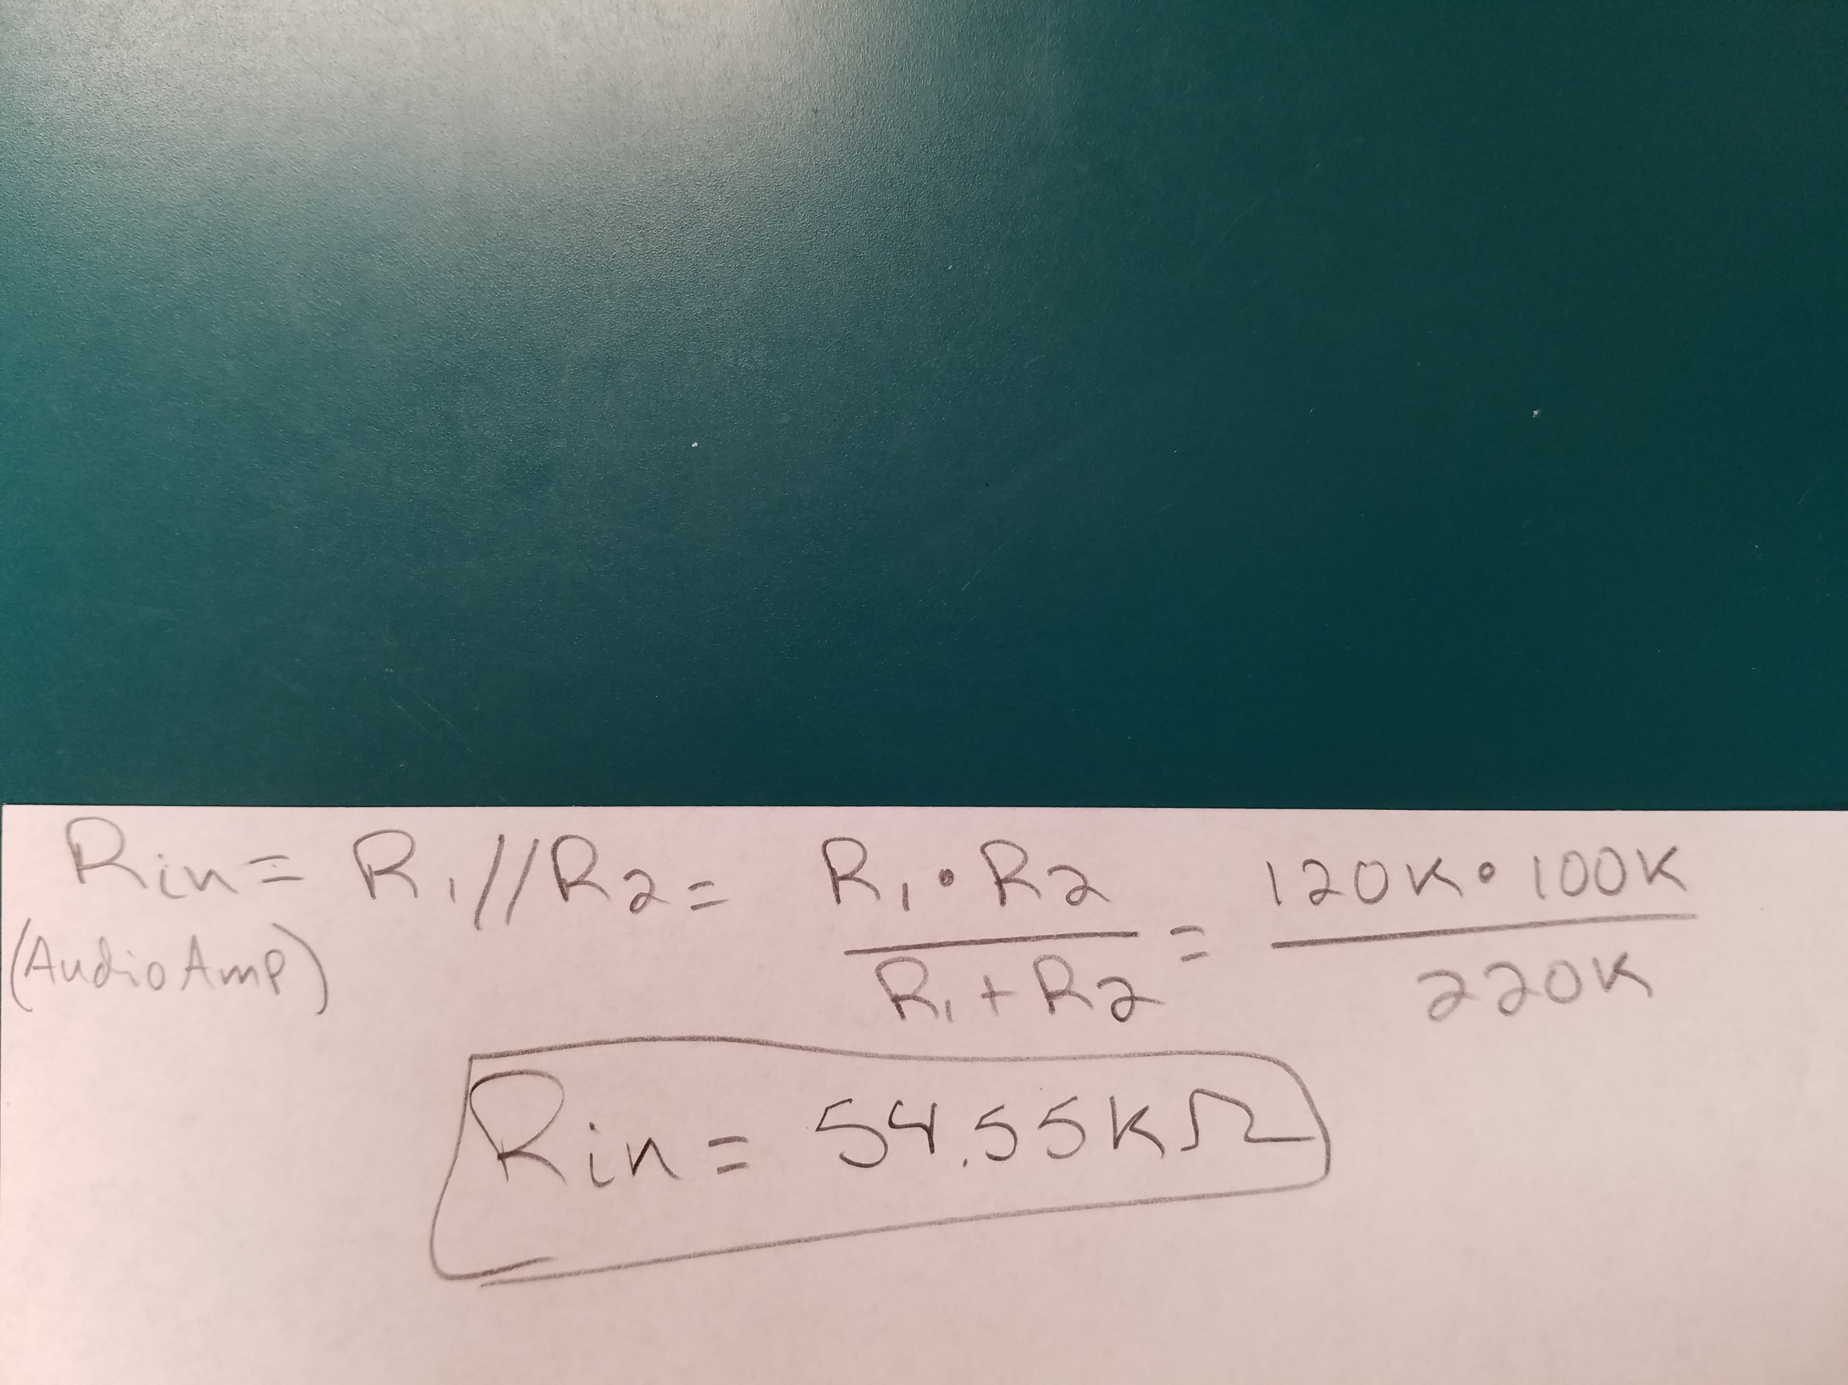
Above is the calculation for the input resistance of the differential stage, which is the overall input resistance of the audio amplifier as well.

Slide 9
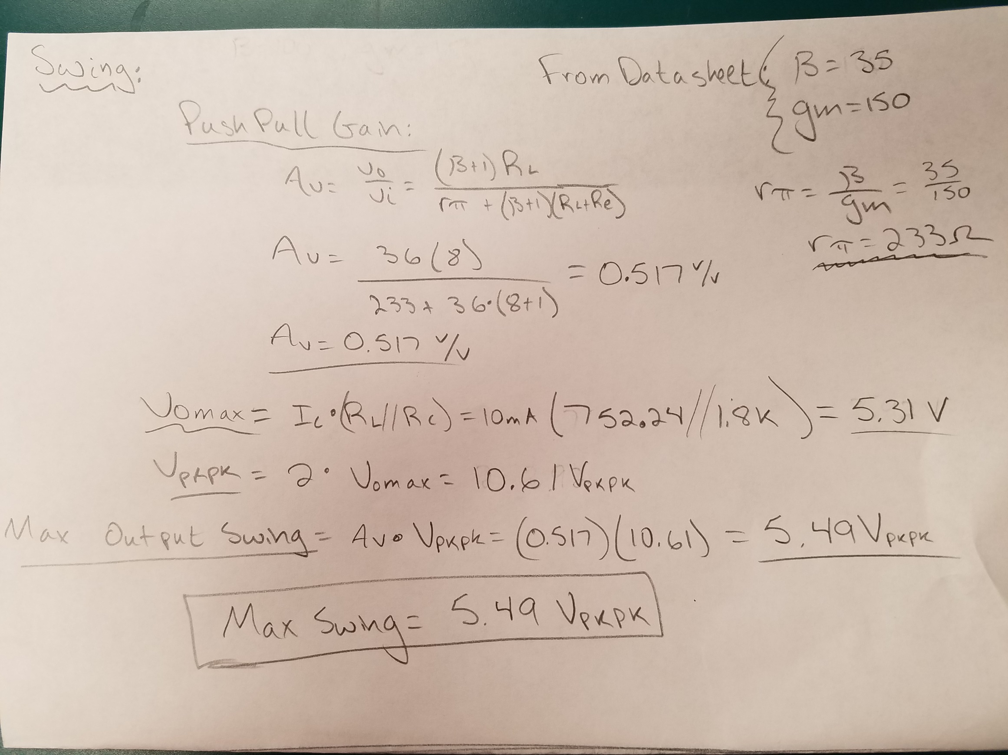

Slide 10
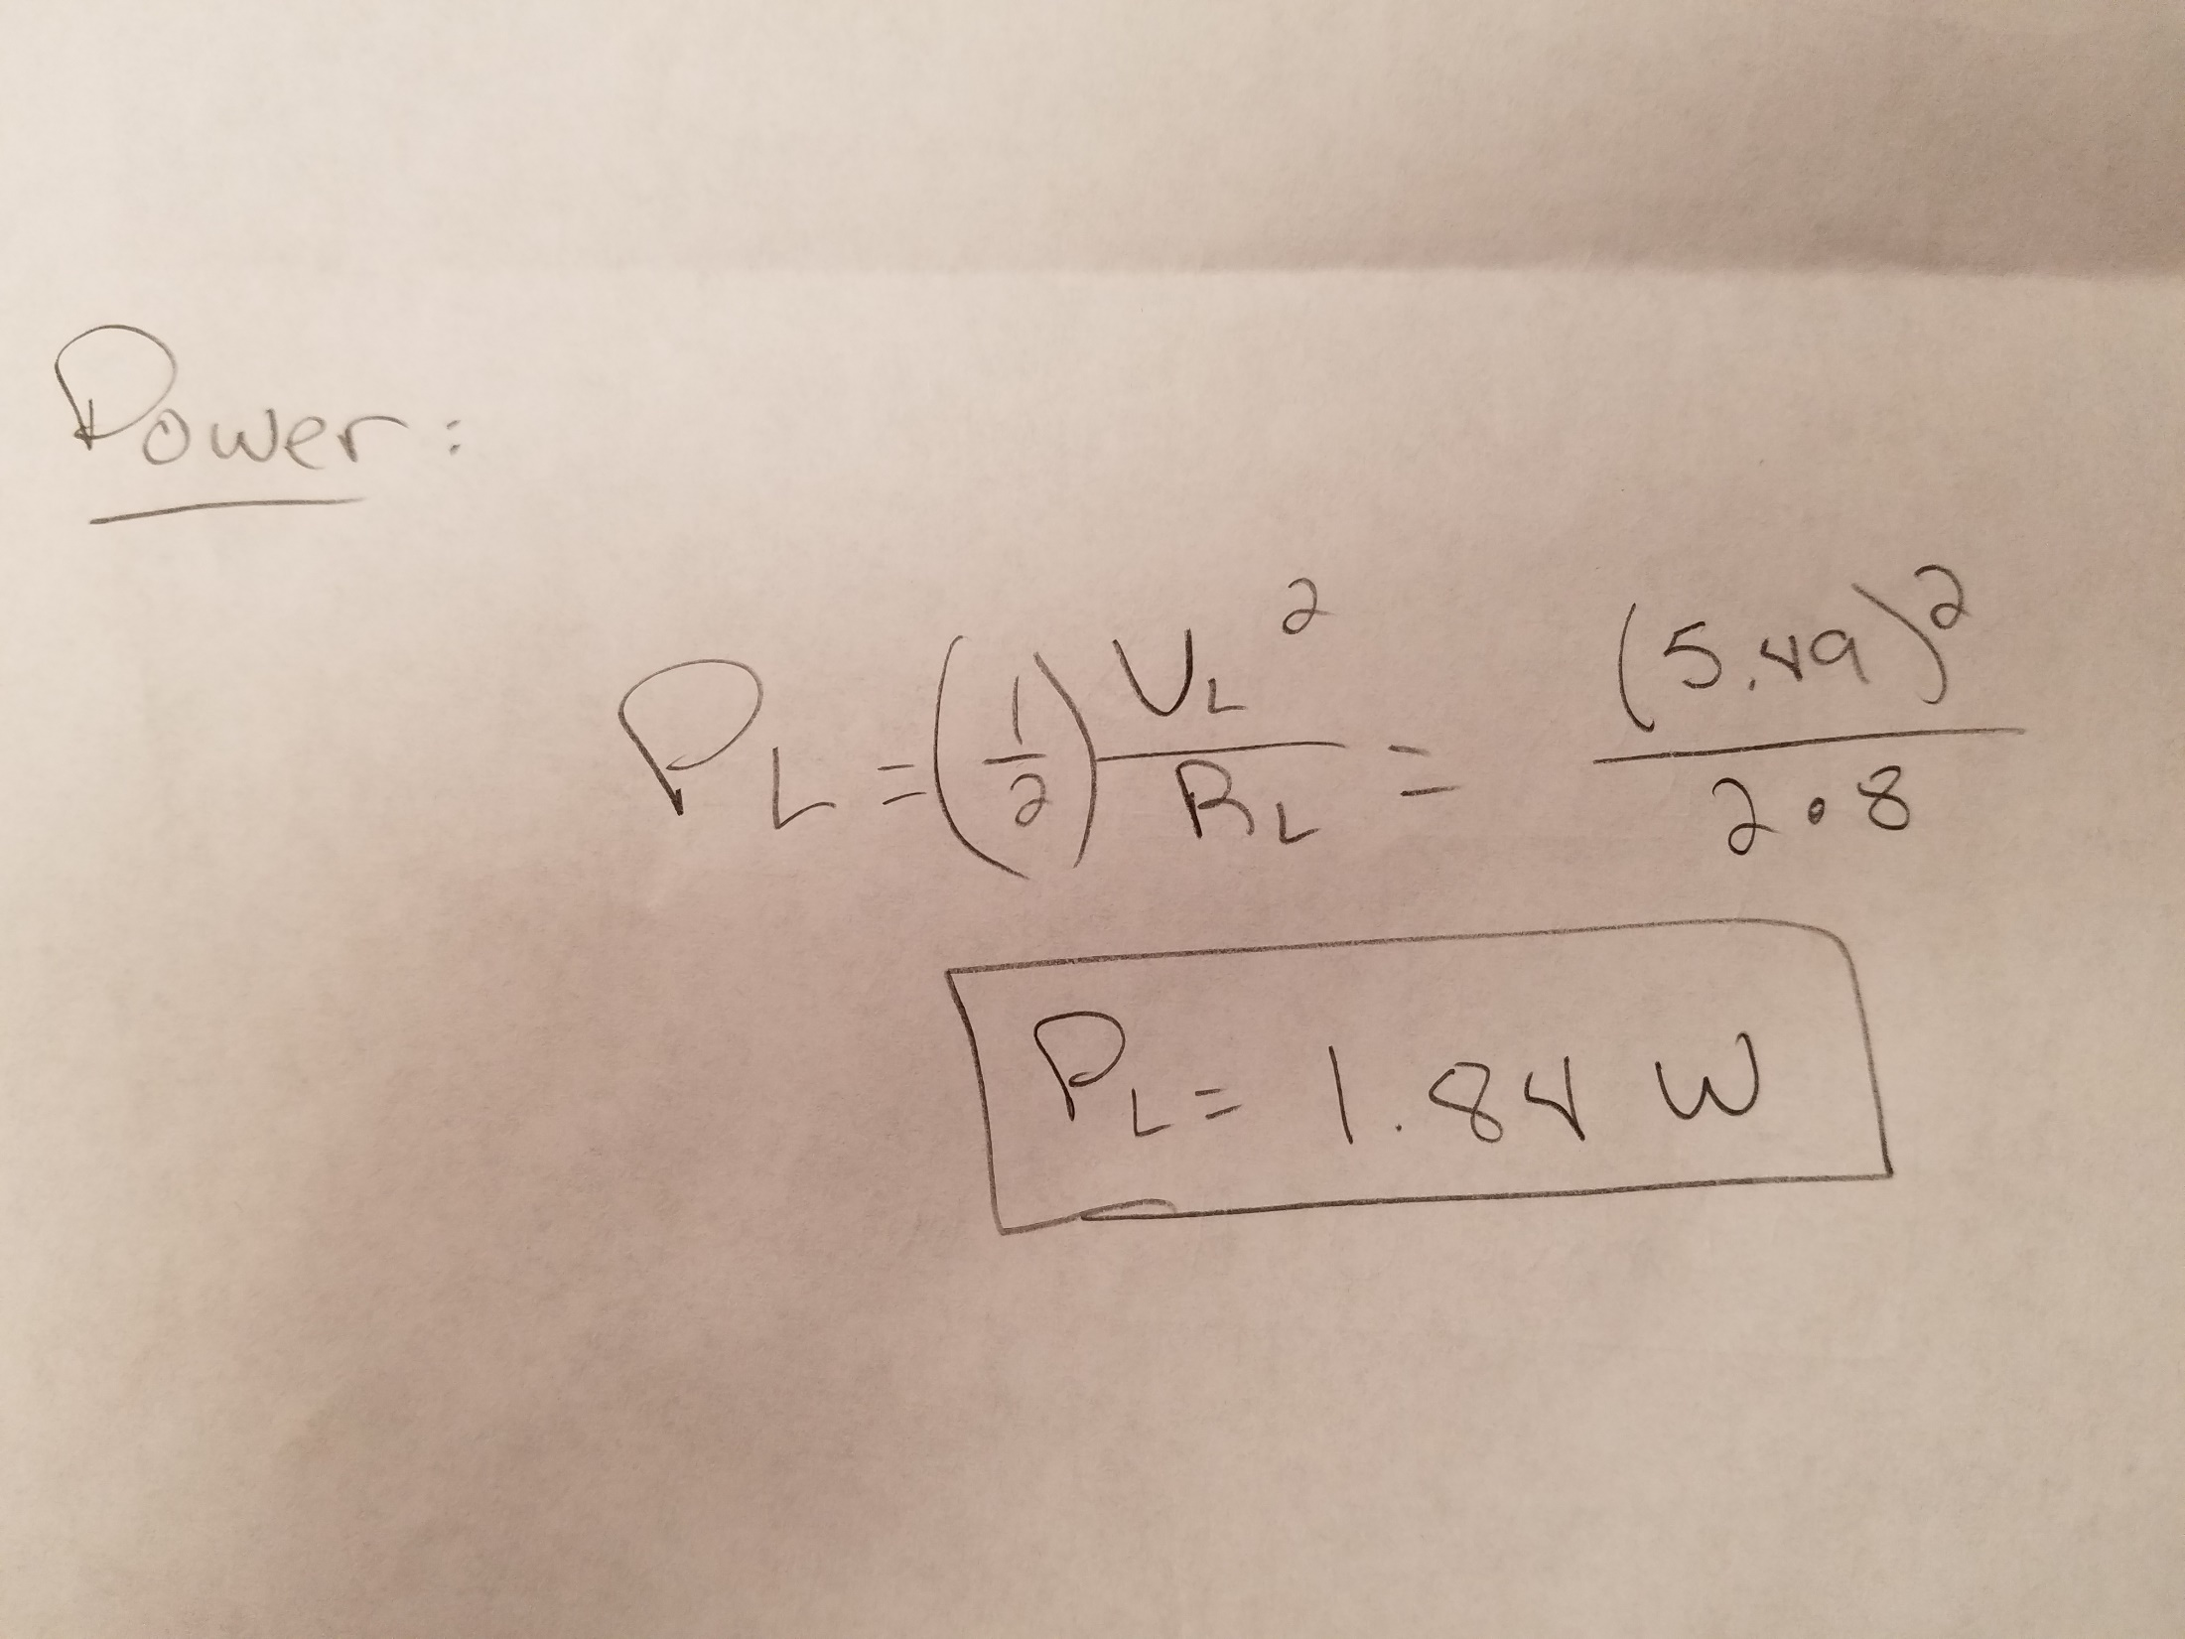

Slide 11
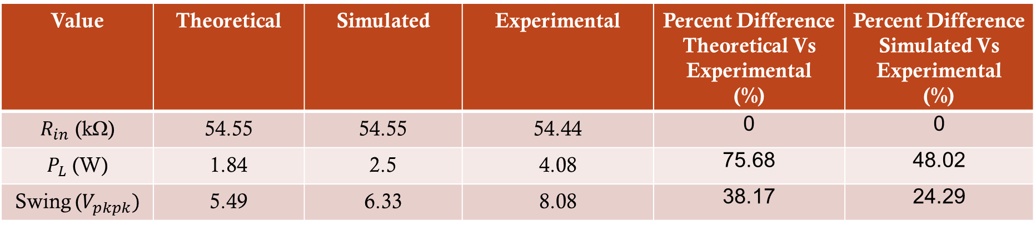
Tabulated Data
Value | Theoretical | Simulated | Experimental | Percent Difference Theoretical Vs Experimental (%) | Percent Difference Simulated Vs Experimental (%)
$R_{in}$ (kΩ) | 54.55 | 54.55 | 54.44 | 0 | 0
$P_{L}$ (W) | 1.84 | 2.5 | 4.08 | 75.68 | 48.02
Swing ($V_{pkpk})$ | 5.49 | 6.33 | 8.08 | 38.17 | 24.29

Slide 12
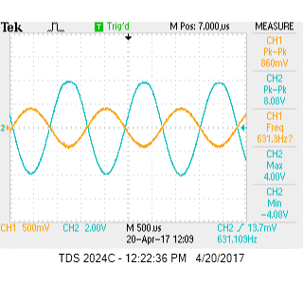
This waveform is the input and output signal of the amplifier at midband frequency.

Slide 13
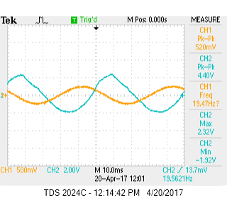
This waveform is the input and output signal of the amplifier at its lower cutoff frequency of 20 Hz. This shows that the 20 Hz lower cutoff frequency spec was reached by my amplifier.

Slide 14
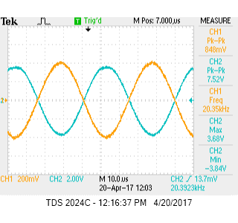
This waveform is the input and output signal of the amplifier at its lower cutoff frequency of 20 kHz. This shows that the 20 kHz upper cutoff frequency spec was reached by my amplifier.

Slide 15
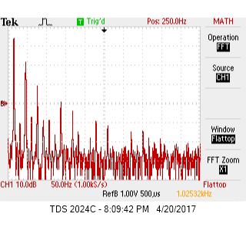
This is the input to the differential stage. The waveform is being viewed in the Fast Fourier Transform mode of the oscilloscope. The spikes in this spectral range are due to harmonics that are distorting the signal.
Notes:
This is the input to the differential stage

Slide 16
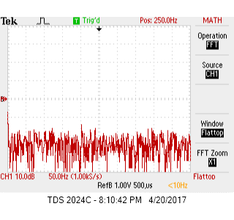
This is the output of the differential stage. The signal noise due to harmonic distortion has been cutout thanks to the effects of the differential stage.
Notes:
This is the output of the differential stage. The signal noise has been cutout.

Slide 17
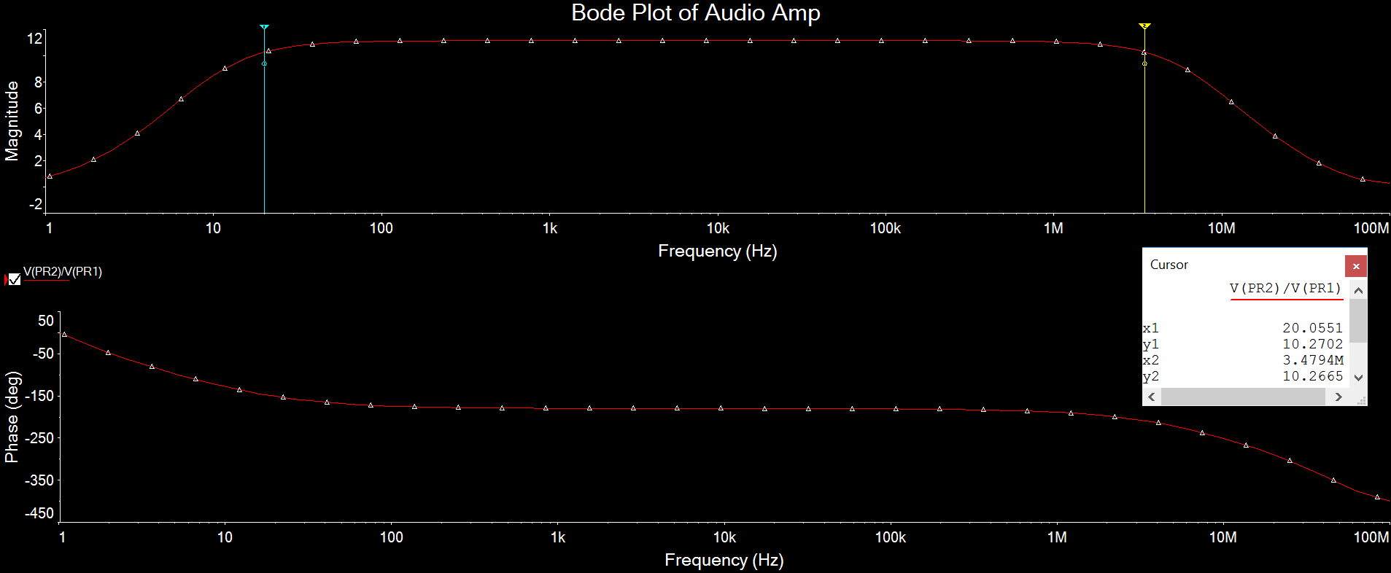
This is the simulated bode plot of the circuit previously shown using Multisim’s AC Sweep Analysis.

Slide 18
Successes
The upper and lower cutoff frequencies were reached.
The board dimensions, class, current source, single ended feed differential, and power supply requirements were reached.
The input impedance was matched to specification.
Bias and temperature stability were accounted for with heat sinks and degenerative resistances.
Harmonic distortion was minimized.

Slide 19
Failures
Overall swing was lower than spec.
Power across the load was slightly lower than spec.
The sensitivity of 500 mV was not fully reached.

Slide 20
Improvements With More Time
I would try to completely eliminate all hum from the circuit, while it is barely just audible as of now.
I would increase the gain and swing of my amplifier so that it was louder.
I would use stereo.

